Slide 1
Creativity Activity Pack
A compendium of resources to help teach creativity
Compiled by
Dennis Sherwood
The Silver Bullet Machine Manufacturing Company Limited
© Dennis Sherwood, 2014

Slide 2
Yes, you too can have great ideas
Is it possible to have great ideas, ‘on demand’?
Most people respond to that question with a resounding “NO!”. “Surely,” they say, “to have great ideas, you have to be a creative person!”
This is wrong. The widely-held belief that only “creative” people can have great ideas is just a myth. Creativity is, in fact, a natural attribute of all human beings, and is a skill everyone can learn, just as everyone can learn to ride a bike.
That’s what this Creativity Activity Pack is all about, for it comprises a collection of insights, exercises, activities and experiences which show how to have ideas ‘on demand’. The Creativity Activity Pack is therefore instrumental in enhancing learners’ key skills of communication, working with others, improving own learning and performance, and – most significantly – problem solving.
The various activities are designed to be both stretching and fun – stretching so that learners, through a carefully planned series of experiences, can successfully navigate a journey of self-discovery, and fun so that their attention is engaged, their imagination stimulated, and their self-confidence enhanced.
Teachers too should enjoy orchestrating the activities with their classes. The exercises should not be too constraining, for I trust that teachers will find the exercises as written will act as a stimulant to their own imaginations to embellish the exercises, or to invent great exercises of their own. It would be great to build a library of these resources, so if you would like to share your ideas, please do contact me at dennis@silverbulletmachine.com.
Dennis Sherwood
© Dennis Sherwood, 2014

Slide 3
Contents
The ‘Eureka’ moment | 1
The light bulb | 3
Standing on the shoulders of giants | 5
What did Beethoven and the Beatles actually do? | 7
Arthur Koestler’s definition of creativity | 9
Tape recorders, the Sony Walkman and the iPod | 11
My Sweet Lord v. He’s So Fine | 13
1,000 things you can do with a brick | 15
The nine dots puzzle | 17
New games based on chess | 19
A new way of unzipping a banana | 21
Let’s be enterprising! | 23
Suggested resources | 26
© Dennis Sherwood, 2014

Slide 4
The ‘Eureka’ moment
Archimedes was one of the world’s greatest scientists, ranking alongside Sir Isaac Newton and Albert Einstein. One day, he was asked by his king to determine whether a particular object was made of solid gold. Archimedes knew that he could do this if he could measure the object’s density – the mass of the object, divided by its volume. He knew how to measure the mass – he could weigh it. But how could he measure, accurately, the volume? This problem stumped him for a long time...until, one morning, he noticed that when he got into his bath, the water level rose – by an amount exactly equal to the volume of his body he had immersed. In a flash he realised that if he immersed the object into a bucket of water, and carefully measured the amount of water displaced, that would accurately determine the volume he needed. According to legend, Archimedes leapt out of his bath exclaiming “Eureka” – which is Greek for “I have found it”. Ever since, that magic moment at which an idea strikes has been known as the Eureka moment.
Activities
Discover as much as you can about Archimedes: in particular:
When did this story take place?
What was the name of the king?
What was the object Archimedes was studying?
Why does knowing the density of this object solve the problem of whether or not it is made of gold?
What else is Archimedes famous for?
How did Archimedes die?
Sir Isaac Newton too had a ‘Eureka moment’.
Where?
What happened?
Why was it important?
Have you ever had a ‘Eureka moment?
In what connection?
What did it feel like?
1
© Dennis Sherwood, 2014

Slide 5
The ‘Eureka’ moment – Teacher notes
Learning objectives
This exercise is intended as a warm-up, with the objective of demonstrating to the learners that behind every great idea is a story. The exercise should also provide an opportunity for learners to be resourceful and enterprising in discovering information for themselves. The questions are also designed to encourage learners to go ‘one step further’, to look beyond the immediate, first step. The third question – enquiring into the learner’s own experience – gives an opportunity for learners to recognise that they, too, have had, and indeed can have, great ideas.
Key outcomes
Enhanced knowledge about Archimedes and Newton.
Increased self-confidence in the ability to research information.
Recognition that everyone has ideas – you don’t have to be ‘Archimedes’ or ‘Newton’.
Notes
There are many, well-documented, examples of ‘the Eureka moment’, of which the stories of Archimedes and Newton are just two (scientific) examples. The teacher may, of course, use any examples he or she wishes, especially if there are some which are more closely allied to other domains such as literature or art.
The exercise has been formulated in terms of a research project: it is of course possible to cover the material in a more direct ‘lecture’ style.
© Dennis Sherwood, 2014
2

Slide 6
The light bulb
One of the most taken-for-granted aspects of every-day life is the light bulb. We go into a room and switch it on; we leave a room and switch it off. We never pay a moment’s attention. But the invention of the light bulb was a great benefit to mankind: before the light bulb, the only way in which man could make light was by burning something, like a candle, an oil lamp or a gas lamp. Burning something is smelly and dangerous – a light bulb is much, much safer.
But who invented the light bulb?
Most people will answer “Thomas Edison”...
Activities
Who holds the UK patent for the light bulb?
Where, and when, did he live?
What other things did this person invent?
The essence of the light bulb is the generation of light by passing an electric current through a thin conducting filament. Who was the first person to observe this phenomenon? Where? When? What was this first conducting filament made of? What needed to happen to make this first ‘electric light’ suitable for use as a means of domestic lighting?
In the light bulbs we use today, what is the filament made of? When was this material first used? What material was used in the light bulb that was first patented?
Why doesn’t the filament in a light bulb just burn up?
Who invented the key piece of equipment to solve this problem?
Overall, what are the three important components of a light bulb? And who invented each component?
So who invented the light bulb?
3
© Dennis Sherwood, 2014

Slide 7
The light bulb – Teacher notes
Learning objectives
This exercise takes the story behind an idea to a deeper level. Once again, one objective is to build the learner’s self-confidence in research. But another, very important, objective is to begin to enhance the learner’s understanding that a ‘big idea’ such as the light bulb does not all happen at once, but builds on pre-existing ideas.
Key outcomes
Enhanced knowledge about how the light bulb was invented.
An awareness that this invention did not happen ‘out-of-the-blue’ but relied on the prior invention or discovery of the vacuum pump, the carbon filament, and the blown-glass envelope.
Notes
As with the activity on ‘The Eureka Moment’, this exercise has also been formulated in terms of a research project: it is of course possible to cover the material in a more direct ‘lecture’ style.
Unravelling this one is quite a challenging task, and so the teacher may wish to offer some help in guiding learners towards finding out about Sir Joseph Swan (who, in December 1878, first demonstrated, and subsequently secured the patent for, the light bulb as we would recognise it today, and who also discovered the carbon fibre filament in 1860), Frederick de Moleyns (who was granted a patent for a light bulb with a platinum filament in 1841), Hermann Sprengel (who developed a powerful vacuum pump in 1865), Sir Humphry Davy (who, around 1802, at the Royal Institution in London, noticed a glow from a platinum wire connected across the terminals of a battery), and, of course, Thomas Edison (who applied for a US patent after Swan’s demonstration, and who also built an entire electricity system comprising generating the electricity, and distributing it to an array of light bulbs simultaneously).
Who, then, ‘invented’ the light bulb? Swan holds the UK patent, but could not have done it without Sprengel; likewise Edison drew on the work of both Swan and Sprengel, as well as others in connection with his systems for electricity generation and distribution. Is it possible to attribute ‘invention’ to a single’ inventor? Or are we always‘standing on the shoulders of giants?’.
© Dennis Sherwood, 2014
4

Slide 8
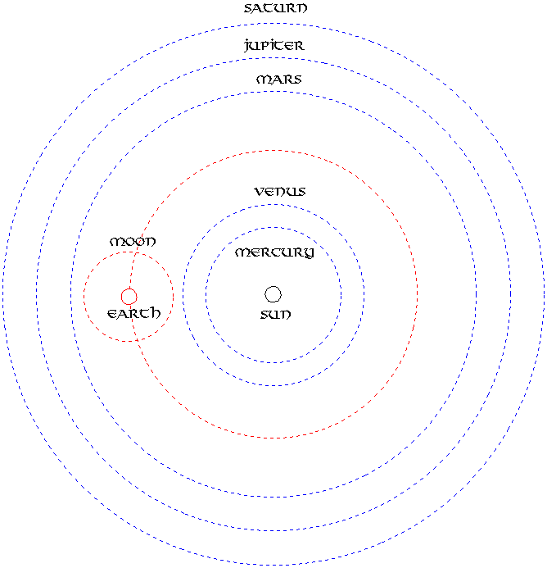
Standing on the shoulders of giants
Sir Isaac Newton famously said “If I have seen further than anyone else, it is because I stood on the shoulders of giants”.
Activities
What do you think Sir Isaac meant when he used the phrase ‘standing on the shoulders of giants’?
Who were the ‘giants’ Newton was referring to? (You should name at least three such ‘giants’.)
What did each of these ‘giants’ do?
What was it that Newton added to the work of the ‘giants’?
5
© Dennis Sherwood, 2014

Slide 9
Standing on the shoulders of giants –
Teacher notes
Learning objectives
This exercise develops matters further by giving learners the opportunity to explore the debt Newton owed to the three (main) giants on whose shoulders he stood: Tycho Brahe, the Danish astronomer; Johannes Kepler, who used Tycho Brahe’s meticulous observations to derive his three laws of planetary motion; and Galileo Galilei, whose systematic observations of moving bodies laid the bases for the scientific interpretation of mechanics.
Key outcomes
Enhanced knowledge about Newton and his predecessors.
Reinforcement of the important concept that ideas do not happen in a vacuum, by accident – rather, they represent a coming together of pre-existing concepts.
Notes
This activity is rather more academic, and requires some knowledge of the appropriate physics and mathematics. The teacher may of course select another example which might be better suited to his or her particular learners.
© Dennis Sherwood, 2014
6

Slide 10
What did Beethoven and the Beatles
actually do?
No-one would dispute that Beethoven, and the Beatles, are wonderfully creative geniuses in their respective fields of classical and pop music respectively.
But what exactly did they do?
What precisely is the nature of their creativity?
Activities
Divide the class, randomly, into groups of about five or six learners.
Give about one-half of the groups the task of describing, as insightfully as they can, all the differences between Beethoven and the Beatles they can think of, capturing their responses as a series of bullet points.
Simultaneously, give the other half of the groups the task of describing, as insightfully as they can, all the similarities between Beethoven and the Beatles they can think of, capturing their responses as a series of bullet points.
After no more than ten minutes, stop the group work, and invite the groups to share their results.
7
© Dennis Sherwood, 2014

Slide 11
What did Beethoven and the Beatles actually do? – Teacher notes
Learning objectives
To demonstrate to learners that all music is formed from different patterns of the same notes – notes that pre-existed the resulting patterns. Neither Beethoven nor the Beatles ‘invented’ any of the notes; rather, they used pre-existing notes to form wonderful patterns-in-time of sound. The essence of a composer’s creativity is therefore one of pattern formation from pre-existing components, rather than de novo ‘creation out-of-the blue’.
Key outcomes
Recognition of the distinction between a pattern (as, in this case, exemplified by a symphony or a pop song) and the component parts from which that pattern is made (in this case, the individual musical notes).
Recognition of the fact that musical creation is all about pattern formation using pre-existing components.
Notes
This activity is always a lot of fun, and does not – of course – require the examples to be Beethoven and the Beatles: any comparison of composers (rather than performers) will work.
It is most unlikely that any group of learners will identify explicitly the model answer that ‘the key difference between Beethoven and the Beatles is that they formed different patterns of sound from the same pre-existing notes’! So there is ample opportunity for you to use all your ingenuity to tease this point out in the group discussion.
© Dennis Sherwood, 2014
8

Slide 12
Arthur Koestler’s definition of creativity
Arthur Koestler was a journalist and author. In one of his books, The Act of Creation, he offers this definition of creativity:
The creative act is not an act of creation in the sense of the Old Testament.
It does not create something out of nothing; it uncovers, selects, re-shuffles, combines, synthesises already existing facts, ideas, faculties, skills.
The more familiar the parts, the more striking the new whole.
Activities
The ‘Beethoven and the Beatles’ activity explored the nature of musical creativity. To what extent does this comply with Arthur Koestler’s definition?
Think about creativity in connection with literature and visual art. How do these map onto Arthur Koestler’s definition? And in each case, what are the ‘patterns’, and what are the ‘component parts’?
Write down a list of brand names – like Nike or iPod - which are not words in our usual language. Inventing a new brand name is a creative thing to do – so how does each name on your list comply with Arthur Koestler’s definition? What are the ‘patterns’? And what are the ‘component parts’.
In biological terms, what is the fundamental difference between each person in your class, and between you and, say, an oak tree? In this case, what are the relevant ‘patterns’ and ‘component parts’? And how does life itself, in which each individual being is truly an act of creation, relate to Arthur Koestler’s definition?
Find out as much as you can about Arthur Koestler. Where was he born? And educated? Why was he in Spain in 1936? What happened to him there? What did he do during the Second World War? In addition to The Act of Creation, what other books did Arthur Koestler write?
9
© Dennis Sherwood, 2014

Slide 13
Arthur Koestler’s definition of creativity – Teacher notes
Learning objectives
To introduce learners to a profoundly insightful definition of what creativity actually is.
Key outcomes
Reinforcement of the distinction between a pattern and the component parts from which that pattern is made.
Reinforcement of the fact that all creativity is all about pattern formation using pre-existing components.
‘Demystification’ of what many people believe to be a somewhat ‘magical’ process: having a new idea is not a ‘mystical act’ – rather, it’s about the discovery of a new pattern of things that already exist, like doing a jig-saw puzzle. And we can all so jig-saw puzzles...
Notes
This activity is designed to reinforce the fact that all creativity is the discovery of new patterns of pre-existing components, as succinctly and elegantly expressed in Arthur Koestler’s definition: literature is formed from patterns of pre-existing words; art is formed from visual patterns of pre-existing coloured pigments; brand names (and all newly coined words) are patterns of pre-existing alphabetical letters; all living creatures are the result of the same four nucleotide bases (adenine, thymine, guanine and cystosine) formed into different patterns in our genes and chromosomes.
The process of forming new patterns from pre-existing components is not random – not any jangle of notes makes good music, just as an arbitrary list of words does not make a novel. Some degree of selectivity and judgement is required to distinguish ‘good’ patterns – and ideas – from the not-so-good, Nonetheless, creativity is fundamentally an orderly, structured process of pattern formation.
© Dennis Sherwood, 2014
10

Slide 14
Tape recorders, the Sony Walkman
and the iPod
Three inventions which have transformed all our lives are the reel-to-reel tape recorder, the Sony Walkman and the iPod. At one level, these are all the same thing – ways of allowing us to play back pre-recorded music, and – in the case of the reel-to-reel tape recorder and the iPod, to record music too.
Activities
Fill in the blanks in the following table, where each column refers to the reel-to-reel tape recorder, the Sony Walkman and the iPod, and each row corresponds to a particular feature.
Who invented the headphone, the loud-speaker, the cassette tape, the CD, the hard drive and the internet?
To what extent does this table give another example of Koestler’s definition of creativity – that all ideas are new patterns of pre-existing component parts?
 | Tape recorder | Walkman | iPod
Size
Portability
Does it record?
Does it play back?
How does it store the music?
What do you use to hear the music?
What is the source of the music?
11
© Dennis Sherwood, 2014

Slide 15
Tape recorders, the Sony Walkman
and the iPod – Teacher notes
Learning objectives
To give another example of the validity of Arthur Koestler’s definition of creativity, and to introduce learners to the importance of observation.
Key outcomes
Further reinforcement of the distinction between a pattern and the component parts from which that pattern is made, and a start in building learner’s confidence in identifying the component parts within a given pattern,
Further reinforcement of the fact that all creativity is all about pattern formation using pre-existing components – neither Sony nor Apple invented any of the key technologies (the headphone, the cassette tape, the CD, the hard disc, the internet) on which they depend.
Notes
* Early models of the cassette Walkman were play-back only.
** Or on cassettes which have been recorded from the radio using another form of cassette recorder.
 | Tape recorder | Walkman | iPod
Size | Big | Small | Very small
Portability | No | Yes | Yes
Does it record? | Yes | No* | Yes
Does it play back? | Yes | Yes | Yes
How does it store the music? | On reel-to-reel magnetic tapes | On magnetic tape cassettes or CDs | On an internal hard drive
What do you use to hear the music? | Through big speakers | Headphones | Headphones
What is the source of the music? | Recorded at home | Purchased pre-recorded cassettes** or CDs | Downloaded from the internet
© Dennis Sherwood, 2014
12

Slide 16
My Sweet Lord v. He’s So Fine
In November 1970, My Sweet Lord, a song written and recorded by the former Beatle, George Harrison, was released in the US, and soon reached No 1 in the pop charts. A few weeks later, in February 1971, a company called Bright Tunes sued George Harrison, alleging that My Sweet Lord was copied from He’s So Fine, the 1963 hit song by the American girl group The Chiffons, the copyright of which was now owned by Bright Tunes.
Activities
Divide the class into an even number of groups of between four and six learners.
Give one half of the groups the task of imagining that they are lawyers representing George Harrison. How would they use Koestler’s definition of creativity to defend him?
Give the other half of the groups the task of imagining that they are lawyers representing Bright Tunes. How would they use Koestler’s definition of creativity to prosecute George Harrison?
When there has been sufficient time for a good discussion, bring all the ‘prosecution’ groups together and ask them to combine their ideas into a single 15-minute presentation, ‘the case for the prosecution’. Similarly, bring the ‘defence’ groups together to formulate ‘the case for the defence’.
The bring everyone together, and invite the prosecution to present their case, then the defence. This should lead to a lively discussion on the specifics of the case, as well as on the more general topic of who, legitimately, can claim ‘ownership’ of a piece of music, or of a new idea in general.
13
© Dennis Sherwood, 2014

Slide 17
My Sweet Lord v. He’s So Fine – Teacher notes
Learning objectives
To give learners an even deeper insight into the essence of creativity, and to give an opportunity to reflect on some challenging issues, such as the problem of attributing rights of origination to an inventor.
Key outcomes
The successful achievement of that objective!
Notes
This activity demands considerable insight and maturity, and is great fun for the appropriate group. It also has the benefit of being real, with the outcome that, in a 1976 judgement, George Harrison lost the case, and was deemed to have plagiarised He’s So Fine. The issue, however, is subtle, especially in the context of Koestler’s definition of creativity. According to this definition, all ideas are just new patterns of pre-existing components, implying, in quite a profound sense, that there is nothing absolutely ‘new’, What, then, is ‘new’? And to what extent does the ‘inventor’ of a pre-existing component have a claim to the final pattern? In this case the patterns under scrutiny are the two pop songs My Sweet Lord and He’s So Fine. Both are patterns of the fundamental notes, and no- one – neither George Harrison nor Bright Tunes - claims ‘ownership’ of the individual notes. The legal issue was at the next level: not individual notes, but small clusters of notes, such as the three-note sequence that comprises the main riffs to which the three syllables My Sweet Lord and He’s So Fine are sung. Everyone would agree that no-one owns the individual notes; but Bright Tunes argued that they ‘owned’ that special three note cluster. Why are those three notes so special? Does anyone ‘own’ any two note clusters? If individual notes are ‘free to use’, why shouldn’t two note clusters, three note clusters, four note clusters... also be free to use? At what point does ‘ownership’ of a note pattern make sense?
And in a more general sense, who can claim that they are the inventor’ or ‘originator’ of any idea, and on what basis can that claim legitimately be made?
This activity is enlivened by having the two songs available for everyone to listen to!
© Dennis Sherwood, 2014
14

Slide 18
1,000 things you can do with a brick
A widely-used psychometric test is to take a familiar object – such as a safety pin, a pencil or a brick – and to invite learners to write down as many uses of the object as they can. The first of these activities is to do just that; the second tackles the problem in a much more powerful way.
Activity 1
Your task is to write down, in 3 minutes, as many different uses that you can think of for a brick.
Activity 2
Look at the picture of the brick carefully.
Individually and in silence, make as long a list as you can of ways in which you would describe the brick. If you wish, you may construct this list in the form of a mind-map.
Then, in groups of about six, share your individual lists to compile a collective list.
For each of the attributes on the collective list, write down as many answers as you can to the question “What else can I use this attribute for?”.
What ideas does this generate as regards how you might use a brick?
How many ideas did you and your team generate?
How does this number compare to the number of ideas you generated in response to Activity 1?
15
© Dennis Sherwood, 2014

Slide 19
1,000 things you can do with a brick – Teacher notes
Learning objectives
To give learners an experience of deliberate creativity – having ideas ‘on demand’.
Key outcomes
Successful generation of ideas.
Recognition of the importance of careful observation.
Recognition that the perception of a group is significantly more powerful than the perception of the individual.
Recognition of the importance of listening carefully to others.
Recognition that the creative power of a group is much greater than the creative power of an individual.
Notes
Activity 1 is straight-forward – 3 minutes is usually more than enough. A score of 10 – 12 ideas is good, above 15 excellent.
The objective of the first part of Activity 2 is to be as observant as possible, to notice things. Most bricks, for example, are hard, have sharp edges, have ‘pointy corners’, are pink or red in colour, have economic value... The learners may benefit from being asked questions such as ‘how big is it?’, ‘what colour is it?’...
Once people notice that the brick is pink, the question ‘what else can I use the property of ‘pinkness’ for? could well trigger ‘as a pigment’. That’s how you can use a brick to restore an old master painting: if you grind a brick to dust, the pink powder than can be suspended on oil to act as a paint of just the right colour for flesh tones. How else can I use the property of ‘economic value’? As a means of exchange – I could use bricks as currency. Especially if they’re made of gold, not clay...
Overall, the learners should discover that they generate many, many more ideas in Activity 2 as compared to Activity 1. This leads to a very important message concerning how to have ideas deliberately: don’t guess or work in a vacuum, as in Activity 1 – rather, describe as carefully as you can what happens now (in this case, this comes down to describing a brick), and then ask questions like “What else can I use [this] for?” or “How might [this] be different?”.
© Dennis Sherwood, 2014
16

Slide 20
The nine dots puzzle
The ‘nine dots’ puzzle – how can you join all nine dots in a 3 x 3 array using only four straight lines and without taking your pencil off the paper? – is a familiar puzzle and party game, and is also often found as a psychometric test of creativity. This activity is a much tougher variant, but rather than tackling it by trial and error, learners should be asked to follow the process, exactly as defined...
Activities
Your task is to discover as many different ways as you can of joining all nine dots in the following diagram, using only a single, straight line.
Don’t guess or use random trial an error, Rather, use this process, and be sure to follow each step precisely and in sequence:
Individually and in silence, write down as detailed a description as you can of what you see in relation to the nine dots puzzle. Write each element of your description as a separate point (for example, there are nine dots; there are three rows; there are three columns...).
Then work in groups of about six, and share your individual lists to form a combined list, representing the group’s collective description.
Then choose one feature, and ask ‘How might this be different?’ and see what happens.
Then choose another feature and do the same thing, and then another...
How many solutions to the puzzle can you discover?
17
© Dennis Sherwood, 2014

Slide 21
The nine dots puzzle – Teacher notes
Learning objectives
To give learners another experience of deliberate creativity – having ideas ‘on demand’.
Key outcomes
Successful generation of new ideas.
Recognition of the importance of careful observation.
Recognition that the perception of a group is significantly more powerful than the perception of the individual.
Appreciation of the importance of asking ‘how might this be different?’.
Recognition of the importance of listening carefully to others.
Recognition that the creative power of a group is much greater than the creative power of an individual.
Notes
The need to solve a problem is often the motivation to discover a new idea. This is an example of deliberate problem-solving and idea generation.
At first sight, everyone says ‘it’s impossible’!
Encourage the learners to write down everything they see. Some things (there are nine dots...) are more ‘obvious’ than others (the paper is flat, the paper is not moving...).
When the groups share, ensure that they share! This is all about listening, not arguing, and appreciating that if someone sees something that way, that’s how they see it.
When the groups start exploring ‘how might this be different?’, help them keep going to the point of discovery. So, if they are asking ‘how might this be different?’ in relation to ‘the paper is flat’, they will probably start off puzzled, then someone will say ‘cube’, leading to someone else saying ‘cone’. Some encouragement might well be needed to keep the group going until someone says ‘folded’, at which point the way in which all nine dots can be joined is immediately obvious. There are many other solutions…
© Dennis Sherwood, 2014
18

Slide 22
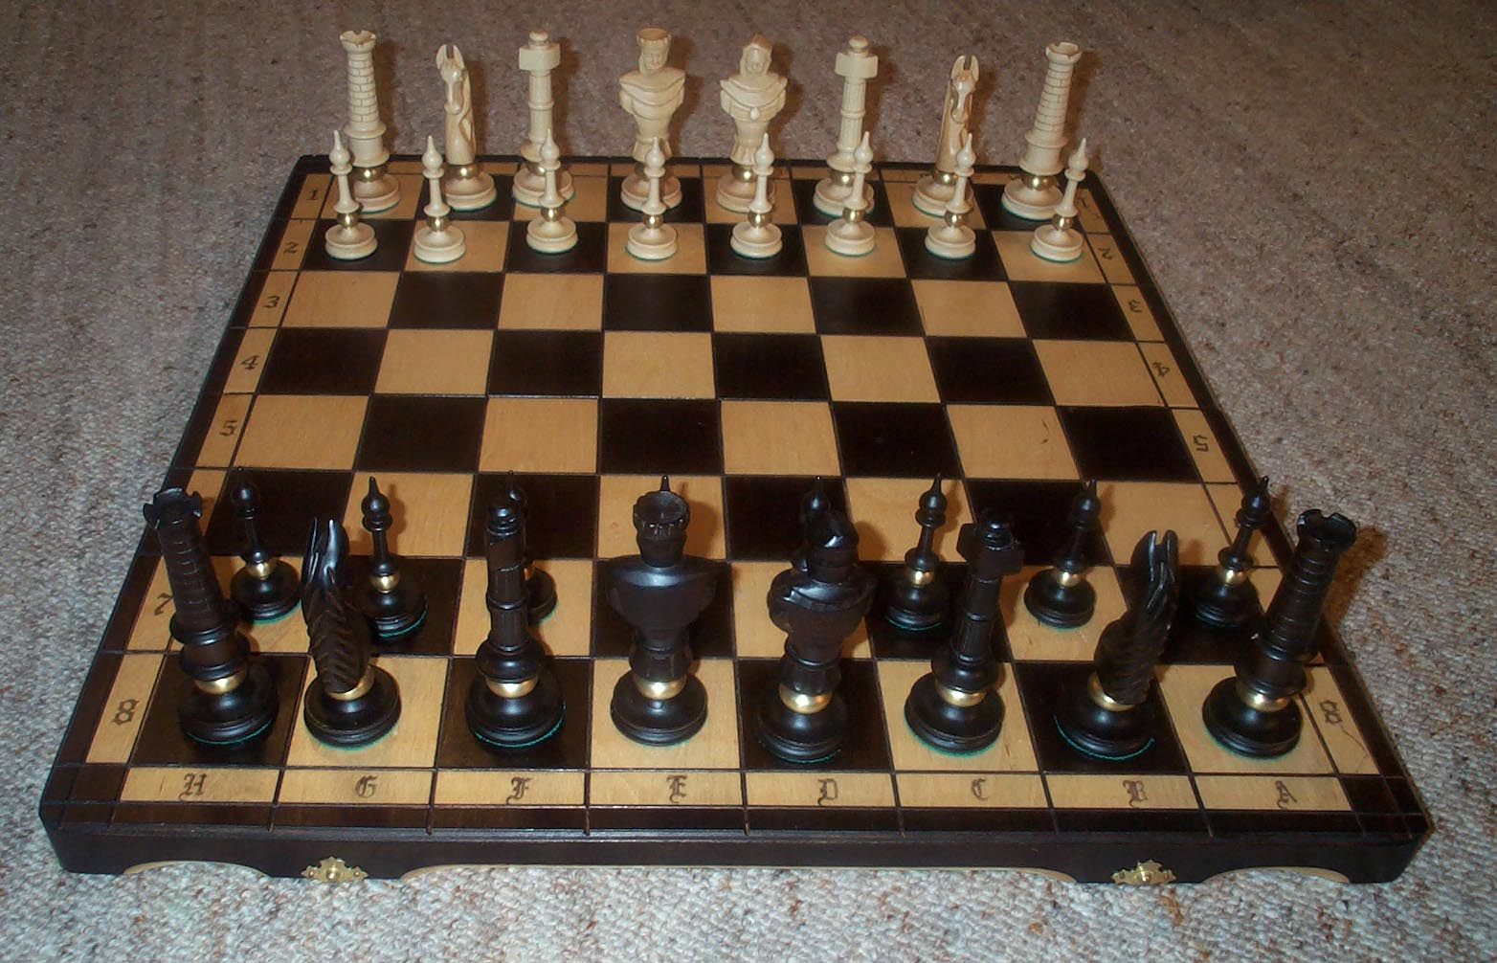
New games based on chess
Chess is an ancient game, and is played all over the world. Chess is played by two players, who move their respective sets of pieces, according to specific rules, with the objective of trapping the opponent’s king in ‘check mate’ – a term derived from the Persian phrase shah mat – ‘the king is dead’.
Familiar stuff. But how many new games can we invent, based on chess?
Activities
Individually and in silence, write down as detailed a description as you can of what you know about the game of chess – what it looks like, how it’s played, what the rules are, what the atmosphere is like... Don’t worry if you don’t know much about chess – you certainly know enough to contribute (there are two players; it’s played on a board...). Write each element of your description as a separate point.
Then work in groups of about six, and share your individual lists to form a combined list, representing the group’s collective description.
Then choose one feature, and ask ‘How might this be different?’ and see what happens.
..Then choose another feature and do the same thing, and then another...
How many new games can you discover?
19
© Dennis Sherwood, 2014

Slide 23
New games based on chess – Teacher notes
Learning objectives
To give learners an experience of deliberate creativity – having ideas ‘on demand’.
Key outcomes
Successful generation of ideas.
Recognition of the importance of careful observation of what happens now.
Recognition that the perception of a group is significantly more powerful than the perception of the individual.
Appreciation of the importance of asking ‘how might this be different?’.
Recognition of the importance of listening carefully to others.
Recognition that the creative power of a group is much greater than the creative power of an individual.
Notes
This activity is not based on there being a problem to solve. There is nothing ‘wrong’ with chess – it works very well as it is. But that doesn’t stop us from generating literally hundreds of ideas...
Encourage learners to notice aspects of chess that are less obvious, such as ‘only one piece can occupy any one square at any one time’; ‘all squares on the board are equal’ (in contrast, say, to the squares on the boards of Scrabble, Monopoly or Snakes and Ladders); and ‘with the exception of one special move of a pawn, each piece maintains its identity throughout the game – a knight is always a knight’.
‘Strip chess’ and many other equally unsavoury concepts are inevitable: try to wean the group away from these as soon as is practicable.
© Dennis Sherwood, 2014
20

Slide 24
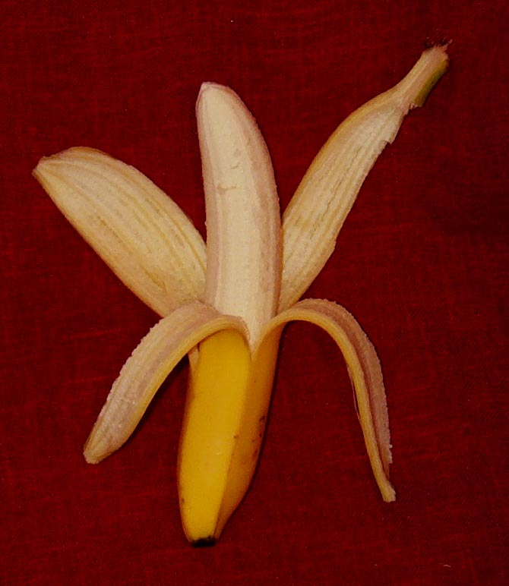
A new way of unzipping a banana
How many different ways can you discover of unzipping a banana?
Activities
Individually and in silence, write down as detailed a description as you can of how you open a banana – what do actually do, in detail? Write each element of your description as a separate point .
Then work in groups of about six, and share your individual lists to form a combined list, representing the group’s collective description.
Then choose one feature, and ask ‘How might this be different?’ and see what happens.
Then choose another feature and do the same thing, and then another...
How many new ways of opening a banana can you discover?
21
© Dennis Sherwood, 2014

Slide 25
New ways of unzipping a banana – Teacher notes
Learning objectives
To give learners an experience of deliberate creativity – having ideas ‘on demand’.
Key outcomes
Successful generation of ideas.
Recognition of the importance of careful observation of what happens now.
Recognition that the perception of a group is significantly more powerful than the perception of the individual.
Appreciation of the importance of asking ‘how might this be different?’.
Recognition of the importance of listening carefully to others.
Recognition that the creative power of a group is much greater than the creative power of an individual.
Notes
This activity is fun – and messy, if you give the learners some bananas to experiment with! Be prepared for ‘squash it against a wall’ - or indeed any other likely, or unlikely, surface!
The idea to encourage is to hold the banana at the stalk end, and then unzip it from the ‘pointy’ end. This is of course exactly the other way round as compared to what people normally do – most people hold the ‘pointy’ end, and break the skin back from the stalk. It turns out, though, that splitting the skin from the ‘ pointy’ end is surprisingly easy, no matter how unripe and hard the banana. For the very good reason that, in nature, the banana is the fruit of the banana plant, and contains the seeds. The stalk of the banana is where it is held on the plant, and so the ‘pointy’ end is the part which naturally splits open to release the seeds – rather like the seed pod of a lily. Arguably, unzipping a banana from the ‘pointy’ end is smarter than unzipping it from the stalk...
...thereby demonstrating that you don’t have to have a problem-to- solve to generate good ideas: “if it ain’t broke, don’t fix it” is not the motto for an innovative society!
© Dennis Sherwood, 2014
22

Slide 26
Let’s be enterprising!
Great businesses are based on great ideas. Now’s your chance...
Activity
Your team’s task is to generate as many ideas as possible as regards one of these areas:
restaurants
a supermarket trolley
mobile phones
television game shows
television reality shows
television soap operas.
Process
In your teams, choose whichever topic on the above list you wish to work on. If you select one of the television options, identify a specific game show, reality show or soap opera.
Individually and in silence, write down as detailed a description as you can of the topic you have chosen. This description must relate to the way the mobile phone, the soap opera (or whatever) is now – not what you might wish it to be in the future.
Then share the individual lists to form a collective team list.
Then, choose an item on the collective list and ask “how might that be different?”. Use this question to trigger as many ideas as you can…
And when you naturally come to a halt, choose another item, and ask “How might this be different?”... and let the ideas flow.
While you are doing this, remember not to criticise one another, but listen as hard as you can, and build on other people’s ideas.
When you have finished with all the items on the list, look through the ideas you have generated, and prepare a presentation of about 15 minutes on the ideas you discovered, and how you discovered them!
23
© Dennis Sherwood, 2014

Slide 27
Let’s be enterprising! – Teacher notes
Learning objectives
To give learners an experience of deliberate creativity in a real sense: there are real businesses out there that actually do this!
Key outcomes
Successful generation of ideas.
Self-confidence in the personal ability to generate ideas.
Recognition of the importance of working on, and contributing to, teams.
Enhanced presentation skills.
A lot of fun!
Notes
This activity is much more open-ended than the other activities, for it is deliberately designed to give learners as rich an opportunity as possible to generate ideas – and to be enterprising!
Once the activity has been explained, the role of the teacher is primarily in helping the teams keep going, and not getting bored or stuck. The teacher should encourage learners to be as perceptive as possible in their descriptions – there is a huge amount that could be potentially be captured when describing a restaurant, a mobile phone or an episode of Who Wants to be a Millionaire?. Every little detail counts! Also, when the teams are asking “How might this be different?”, there is always the tendency to smut and infantilism – so help the teams get through this to discover as many good ideas as they can!
In this regard, the teacher might wish to have some ‘model answers’ in mind so the teams can be guided to some ‘interesting places to look’.
© Dennis Sherwood, 2014
24

Slide 28
Suggested resources
All of the material in this Activity Pack is based on materials to be found in the author’s two main texts on deliberate creativity – Unlock Your Mind (published by Gower Publishing in 1998) and Smart Things to Know about Innovation and Creativity (published by Capstone in 2001). These sources contain detailed explanations of all the key matters explored here – such as Koestler’s definition of creativity, the nine dots puzzle and new games based on chess.
Further helpful resources are:
Tony Buzan – The Mind Map Book: Radiant Thinking (BBC Books, 2003) – Mind mapping is a great way to define what you see,
Edward de Bono – Children Solve Problems (Penguin Books, 1972) – this book will trigger lots of other activities you can try.
Arthur Koestler – The Act of Creation (Arkana, 1989) - Koestler’s definition of creativity will be found on page 120.
Roger von Oech – A Whack on the Side of the Head (Creative Think, 1992) – this book is a lot of fun, and is the companion volume to The Creative Whack Pack, a set of ‘playing cards’ designed to help stimulate creativity.
25
© Dennis Sherwood, 2014

Slide 29
Idea generation, evaluation and development
Silver Bullet Building ultimate
competitive advantage
Making innovation happen
Strategy development and scenarios
Building
high-performing teams
Training and knowledge transfer
Conferences
Business and market modelling
The Silver Bullet Machine Manufacturing Company Limited
Barnsdale Grange, The Avenue, Exton, Rutland LE15 8AH
E-mail: dennis@silverbulletmachine.com
Website: www. silverbulletmachine.com
Telephone and fax: 01572-813690
Mobile and messages: 07715-047947

